Slide 1
USER’S GUIDE
RIKEN Arabidopsis Transposon-tagged Mutant (RATM) Line Catalogue Database

Slide 2
START YOUR SEARCH
Select resource type
psh: homozygous line
pst: no information for zygosity
Enter information
Resource Number: named by RIKEN BRC, used in MTA and order forms
Line name: named by RIKEN GSC
AGI(TAIR10) code: gene number of Arabidopsis annotated by TAIR
Click here to start search

Slide 3
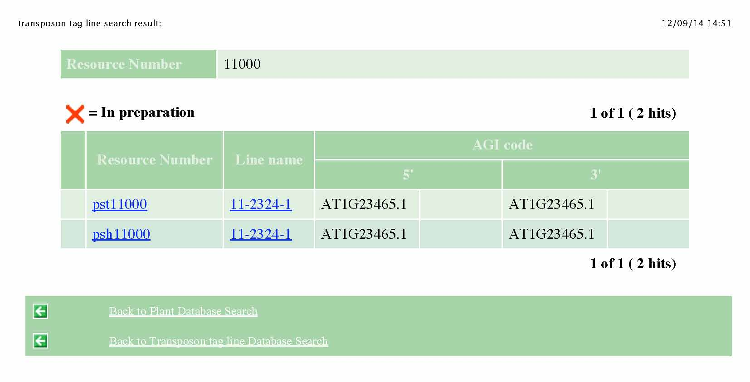
CHECK CANDIDATE LINE LIST
Gene(s) near the insertion site
5’: neighbor gene(s) predicted from the 5’-end flanking sequence
3’: neighbor gene(s) predicted from the 3’-end flanking sequence
Candidate line(s)
(click to open the information page)
psh: homozygous line
pst: no information for zygosity
Line name
(click to open the information page)

Slide 4
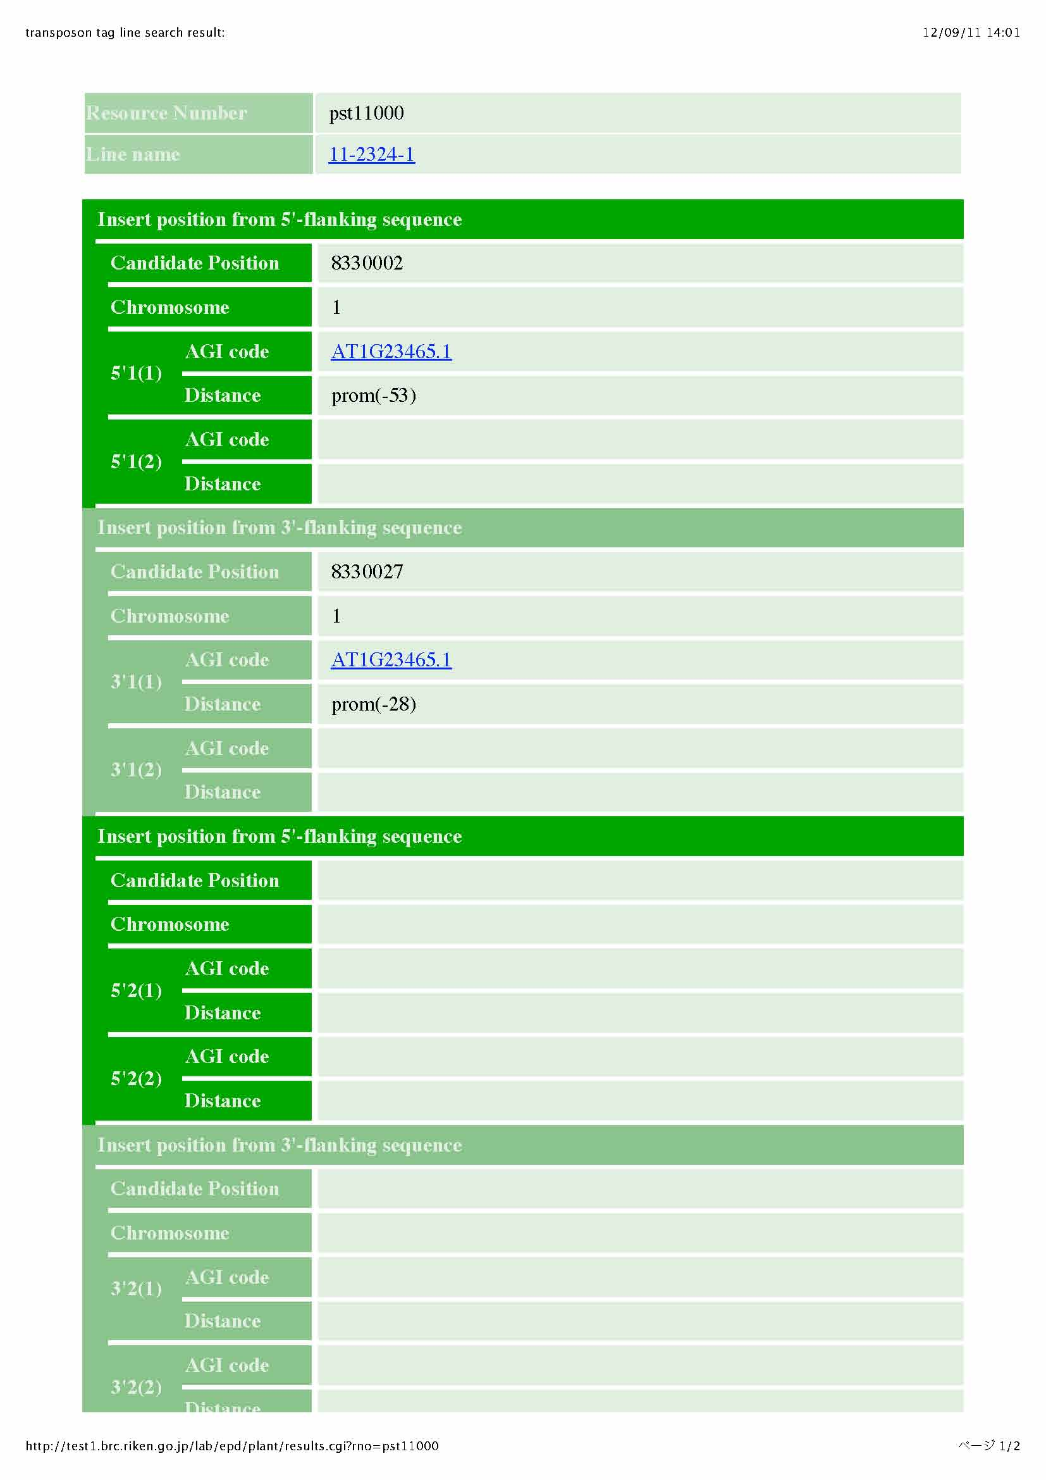
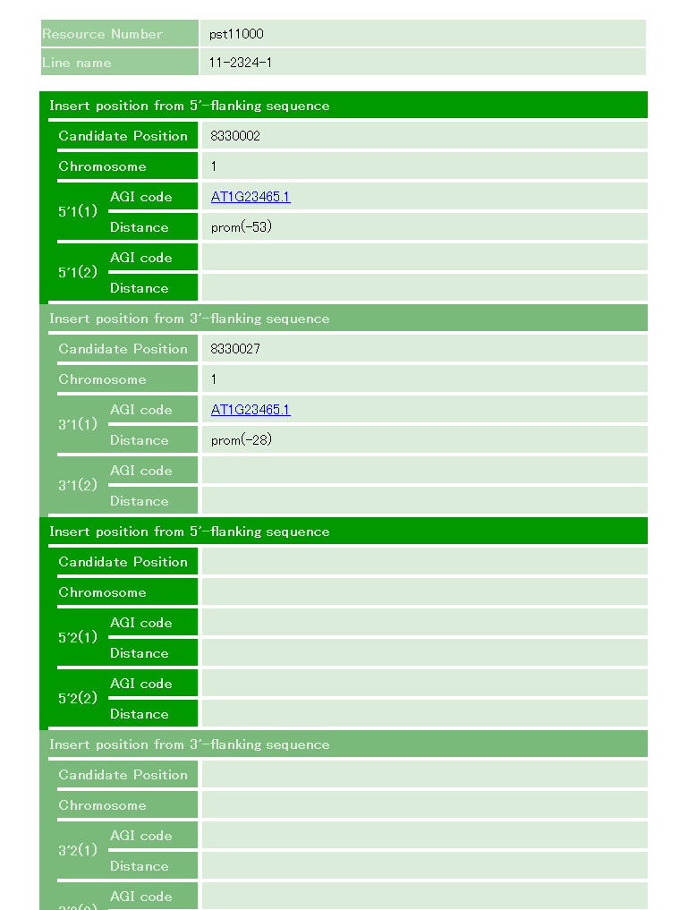
FIND DATA FOR EACH LINE
Line name
Ds insertion site information predicted from 5’- and 3’-end flanking sequence
Candidate Position: location on the corresponding chromosome
5’1(1)/3’1(1): AGI code of the nearest gene and the position of Ds insertion
5’1(2)/3’1(2): additional gene information when the location of Ds insertion is intergenic
Some lines have two or more candidate positions for Ds insertion. This is because of the redundancy in the Arabidopsis genome.
Additional candidate site (when applicable)

Slide 5
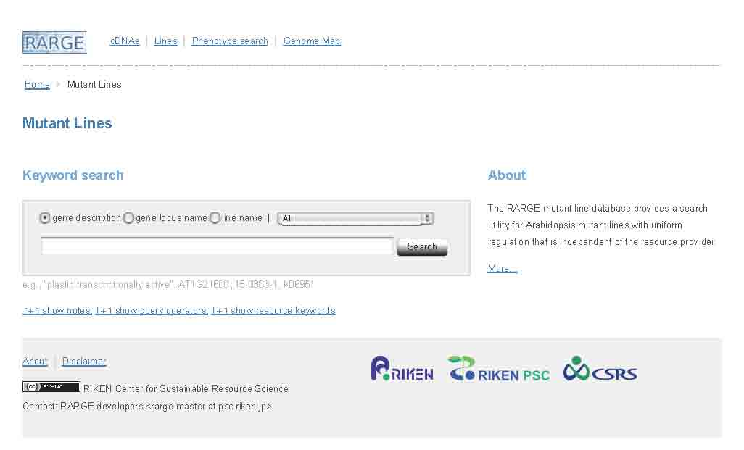
GET MORE INFORMATION FROM RARGE DB (Optional, map position/flanking sequence available )
http://rarge-v2.psc.riken.jp/line
Enter line name (Dsxx-xxxx-x) here
RIKEN BRC confirms the insertion site before shipment.
The information obtained from the analysis will be informed to the user.

